Slide 1

Guideline of using ericsson exposed charging APIs
Robert Liu
Updated: 2015-04-02

Slide 2
A glance at Exposed apis
SMS API
  This API enables the authorized caller to send the SMS messages to one or more mobile terminals
Location API
  This API enables the authorized caller to query Location of a mobile device.
Payment API
  This API enables the authorized caller to charge/refund an end user.
M2M Data API (with Car Emulator)
  This API enables the authorized caller to read the car related data, change the status of the car and get the sensor data history of the car.
  There is a Car Emulator to visualize all data which is associated with the vechicle.

Slide 3
GSMA SMS API
Introduction
  The authorized caller is able to send the SMS messages to one or more mobile terminals
HTTP request
URL | http://<serverRoot>/oneapi/sms/1/outbound/<senderAddress>/requests/
Query String Note: The query strings are according to facebook API document. | Parameter | Description | Mandatory or Optional
 | senderAddress | It is the address to which a responding SMS is sent. senderAddress in URL and payload must be same. | Mandatory
 | message | The message content which is going to be sent to the senderAddress, the length of it must be less than 140 characters | Mandatory
 | clientCorrelator | It uniquely identifies the request | optional
HTTP Method | POST
Request format | application/json
Response Format | N/A

Slide 4
GSMA SMS API
Example:
Post: http://52.28.33.220:3000/oneapi/sms/1/outbound/tel%3A%2B123456789/requests
{
"outboundSMSMessageRequest":
{
"address": ["tel:+8613500220836"],
"clientCorrelator": "10002",
"outboundSMSTextMessage":
{ "message": “Hello world!" },
"senderAddress": "tel:10086",
"senderName": “Hacker"
}
}
HTTP response status code
Request body
HTTP status code | Description | Note
200 | Successful
500 | Internal server error
400 | The syntax of the request is not correct.

Slide 5
GSMA Location API
Introduction
  The authorized caller is able to query Location of a mobile device.
HTTP request
URL | https://<serverRoot>/oneapi/location/1/queries/location?address=<address>&requestedAccuracy=<metres>
Query String Note: The query strings are according to facebook API document. | Parameter | Description | Mandatory or Optional
 | address | The MSISDN in tel URI(RFC3966) format of the mobile device to locate. At least one address must be provided. Repeat the address parameter for multiple devices. "tel:" scheme and "+" identifier must be used for address, and must be URL-escaped. In the above example, the recipients MSISDN is in tel URI(RFC3966) format. %3A represents ":" and %2B represents "+". Thus tel%3A%2B4605010759 represents tel:+4605010759. | Mandatory
 | requestedAccuracy | It is the preferred accuracy of the result, in metres. Generally, it takes longer time to retrieve an accurate location than a coarse location | Mandatory
HTTP Method | GET
Request format

Slide 6
GSMA Location API
HTTP response status code
Response body
HTTP status code | Description | Note
200 | Successful
500 | Internal server error
400 | The syntax of the request is not correct.
Name | Description
address | The terminal located, as per RFC 3966. Only international number issupported.
accuracy | The result accuracy in metres.
altitude | The altitude of location in meters.
latitude | The latitude of location in decimal degrees, ISO 6709.
longitude | The longitude of location in decimal degrees, ISO 6709.
timestamp | In xsd:dateTime format.
locationRetrievalStatus | Location retrieval status, with following possible values:

Slide 7
GSMA Payment API
Introduction
  The authorized caller is able to charge/refund an end user.
HTTP request
URL | endUserIderRoot>/oneapi/payment/1/<endUserId>/transactions/amount
Query String Note: The query strings are according to facebook API document. | Parameter | Description | Mandatory or Optional
 | endUserId | It is the identity of the end user to be charged. tel URI is used as the user identity. Only global number is supported. "tel:" scheme must be given. For example, tel%3A%2B8613500000000 The endUserId value in URL and payload must be same. | Mandatory
 | referenceCode | The message content which is going to be sent to the senderAddress, the length of it must be less than 140 characters | Mandatory
 | transactionOperationStatus | This indicates the desired resource state. Set to ‘Charged’ to deduct money from user’s account, and set to ‘Refunded’ to refund user. | Mandatory
 | description | It is the human-readable text to appear on the bill. Then user can easily see what they bought. | Mandatory
 | currency | It is the 3-figure code as per ISO 4217. | Mandatory
 | amount | It can be a whole number or decimal. | Mandatory
HTTP Method | POST
Request format | application/json

Slide 8
GSMA Payment API
Example:
Post: http://52.28.33.220:3000/oneapi/payment/1/tel%3A%2B123456789/transactions/amount
{
"amountTransaction": {
"clientCorrelator": "100003",
"endUserId": "tel:+13500220836",
"paymentAmount": {
"chargingInformation": {
"amount": "10.01",
"currency": “EUR",
"description": [”Charge subscriber"]
}
},
"referenceCode": "REF-NJD-12345a",
"transactionOperationStatus": "CHARGED"
}}
HTTP response status code
HTTP status code | Description | Note
200 | Successful
500 | Internal server error
400 | The syntax of the request is not correct.

Slide 9
M2M data (Vehicle) API
Introduction
  The authorized caller is able to read the car related data, change the status of the car and get the sensor data history of the car.
Read/update car information API
Read the sensor logs API
URL | http://<serverRoot>/vehicle/v2/<vin>
Query String | Parameter | Description | Mandatory or Optional
 | vin | Represents the vehicle identification number | Mandatory
HTTP Method | GET / POST
Request format | application/json
URL | http://<serverRoot>/vehicle/v2/<vin>/drivelogs/<timestamp>
Query String | Parameter | Description | Mandatory or Optional
 | Timestamp | This parameter is used to filter the data which is generated after the specified data, it is the number of seconds that have elapsed since January 1, 1970 (midnight UTC/GMT) | Mandatory
 | vin | Represents the vehicle identification number | Mandatory
HTTP Method | GET
Request format | application/json

Slide 10
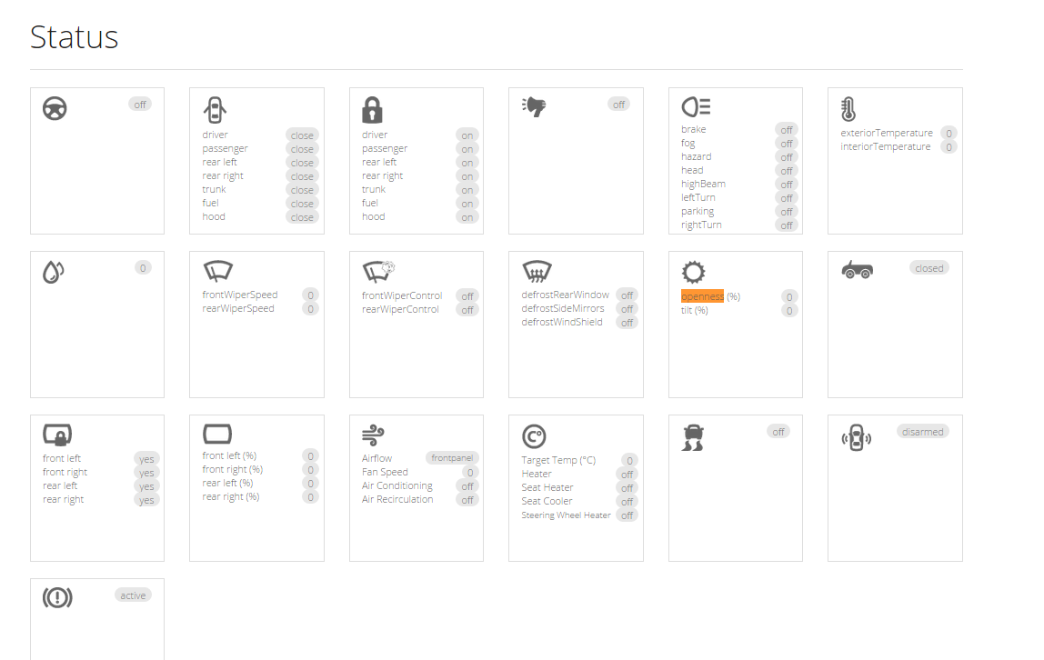
M2M data (Vehicle) API
HTTP response status code
Response body
  Please reference to
  https://github.com/wenzheng/hackathon/blob/master/vehicle-api-postman.json
  for detailed vehicle API response parameters
  Most of the data presented in the API can be manipulate/viewed by the car
  emulator: http://52.28.33.220/
HTTP status code | Description | Note
200 | Successful
500 | Internal server error
400 | The syntax of the request is not correct.
404 | Resource not found

